Slide 1
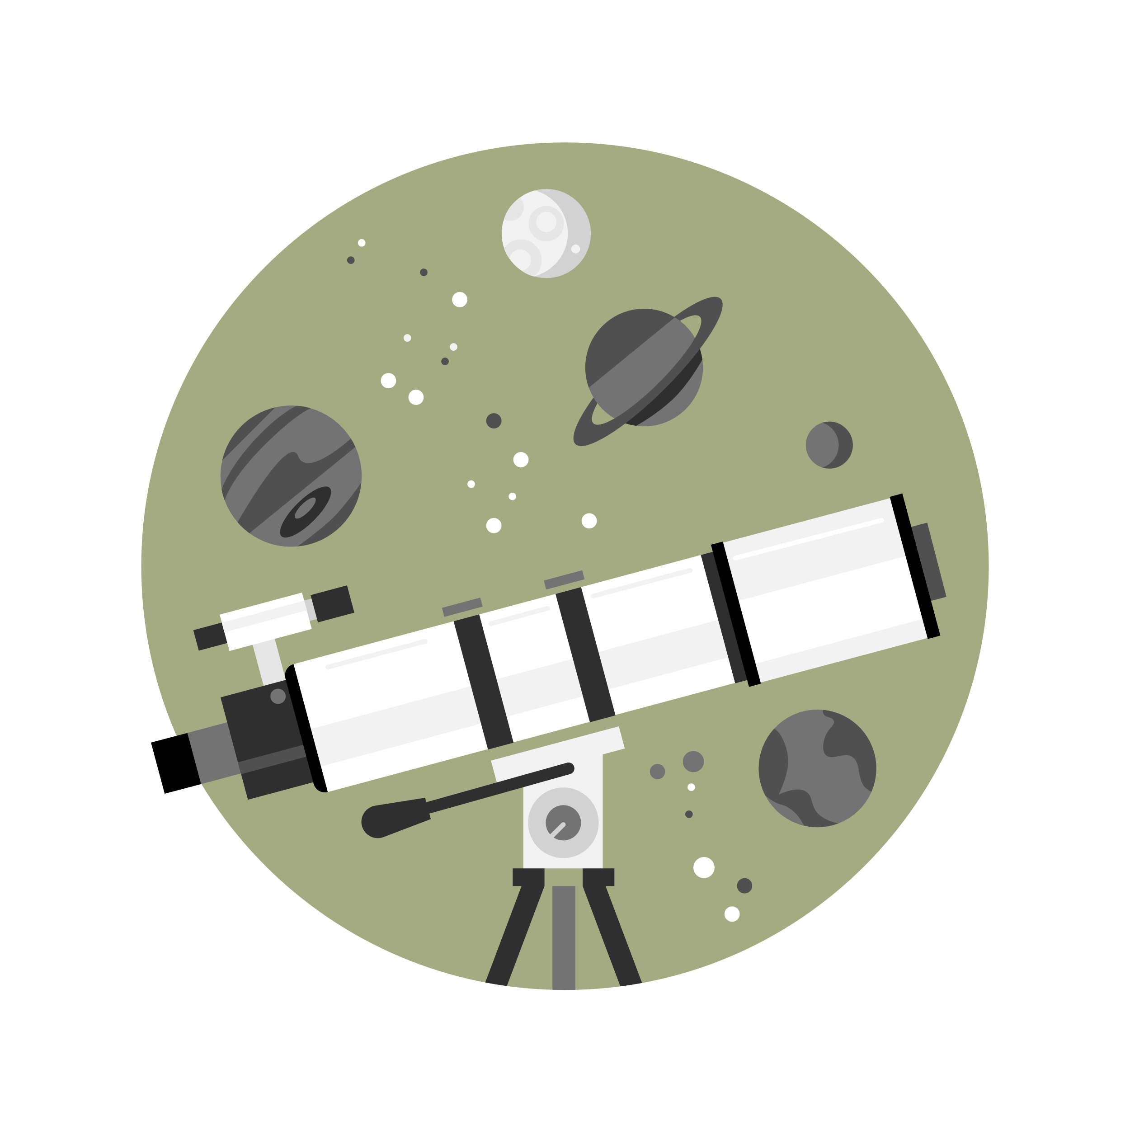
CREATING ARTIFICIAL GALAXIES USING GENERATIVE ADVERSARIAL NETWORKS
By: ahmed lawal
Supervisor: dr. kevin pimbblet
Notes:
Hello and welcome to my presentation: CREATING ARTIFICIAL GALAXIES USING GENERATIVE ADVERSARIAL NETWORKs (GANs).
My name is Ahmed Lawal.

Slide 2
Research Outline
Introduction, Background, and Related work
Results and Evaluation
Data
Benchmark
Methodology
Conclusion
Notes:
The main question of this research is “Can I create artificial galaxies using GAN to fool an expert?
To answer this, below is an outline of the presentation:
We begin with an introduction to Generative adversarial Networks and the domain of its application in this research, then i’ll give a background to the study and some related work.
Next, i’ll briefly describe the data used for the project.
This will be followed by the methodology adopted for the research.
The experimental results and evaluation methods will be described next.
This will be followed by a benchmark of the results.
To wrap up the presentation, I’ll highlight the key achievements of the research.

Slide 3
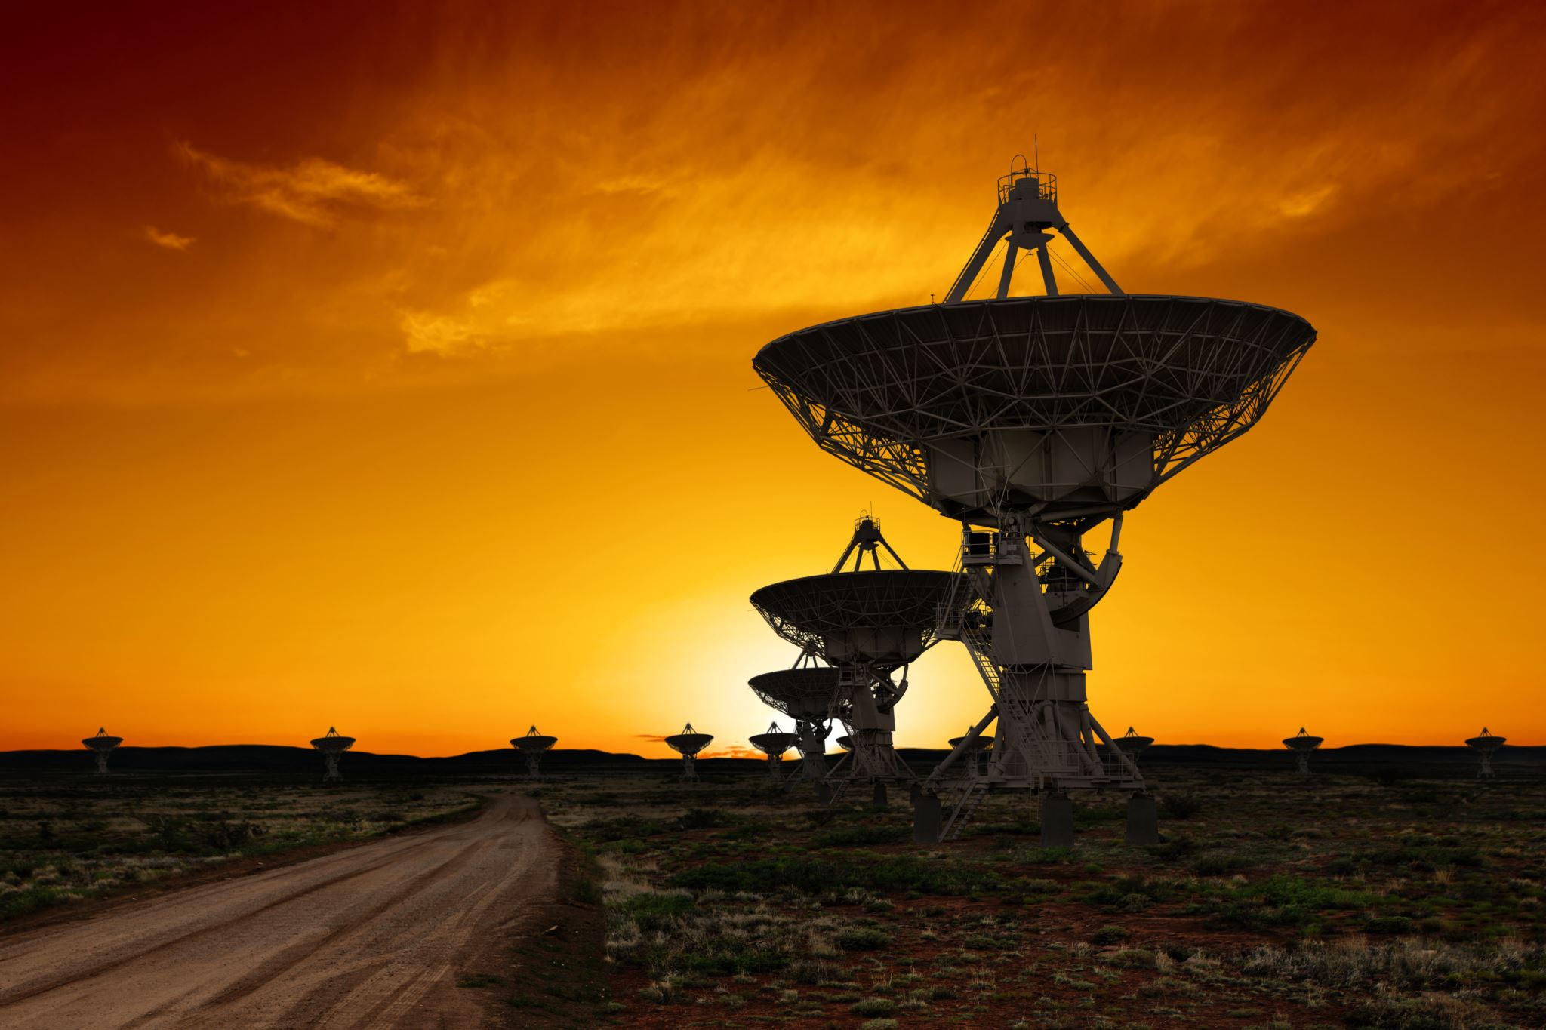
Introduction to generative adversarial networks (GANs)?
GANs are generative models that use two neural networks to create fake data.
Artificial galaxies are required to match the growing research into galaxies.
GENERATOR
DISCRIMINATOR
Forge data
Classify data
Notes:
Generative adversarial network (GANs) is a new breed of artificial intelligence technology introduced by Ian Goodfellow in 2014 for creating fake media that looks real. This was popularly known as deepfake.
GANs are an approach to generative models that use neural networks to produce synthetic data via a game of two adversaries: The Generator and the Discriminator.
The goal of the generator is to create new and plausible samples that are convincing enough to fool the discriminator.
The discriminator on the other hand takes a sample from the domain as input and predicts a binary class target of real or fake.
The generator and the discriminator motivate each other to improve in their capabilities as training continues until a point where the generator produces realistic images, and the discriminator fails at distinguishing fake from real ones.
This research was motivated by astronomers’ need to test algorithms that measure the parameters of galaxies. The study and classification of galaxies in parametric research can be challenging and computationally intensive, hence a set of artificial galaxies become necessary.

Slide 4
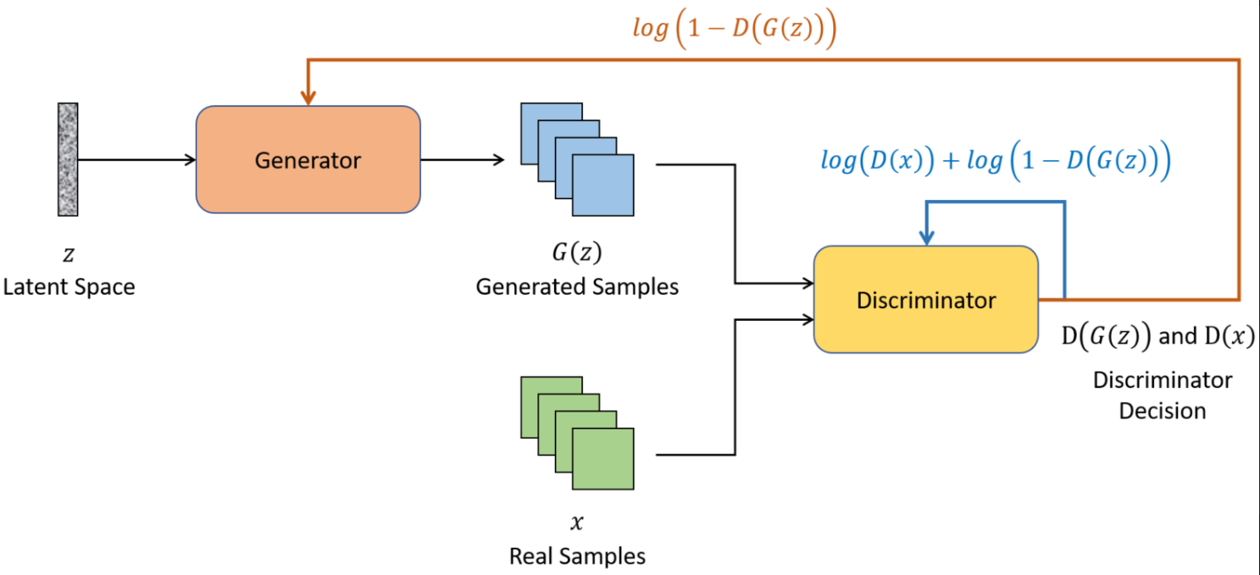

background
GAN training operation is expressed by the value function:
$\min_{G}\max_{D}V\left(D,G\right)=𝔼_{x∼Pdata\left(x\right)}\left[logD\left(x\right)\right]+𝔼_{z∼Pz\left(z\right)}\left[\log\left(1−D\left(G\left(z\right)\right)\right)\right]$.
The discriminator wishes to maximize the likelihood of identifying actual data (D(x)) as real and created data (D(G(z))) as fake.
The generator wishes to reduce the chance that the discriminator would label the data it generates, (G(z)) as "fake."
The GAN Architecture (Source: Vint et al., 2021).
Notes:
Deepfake, a combination of deep learning and fake uses GANs to produce artificial but plausible media. From photoshop to TikTok, digital media has exploded in the 21st century developing into several open source deep fake algorithms and resulting in an increasing number of synthesised media. Using a large dataset of real images in a GAN training, the goal of the generator is to create images G(z) that are like the real images,x.
Then the Discriminator, D is expected to identify the images as either G(z)(Generated) or (x)(real).
The generator is trained to minimize the function Log(1- D (G(z))).
This teaches the generator to create images that the discriminator cannot tell are fake. i.e The Discriminator’s prediction of G(z) is as close to 1 as possible.
The discriminator is trained to maximize the function Log (D(x) + Log (1 – D(G(z))), maximizing the likelihood of correctly identifying real samples (D(x)) while also accurately identifying the generated samples (D(G(z))).

Slide 5
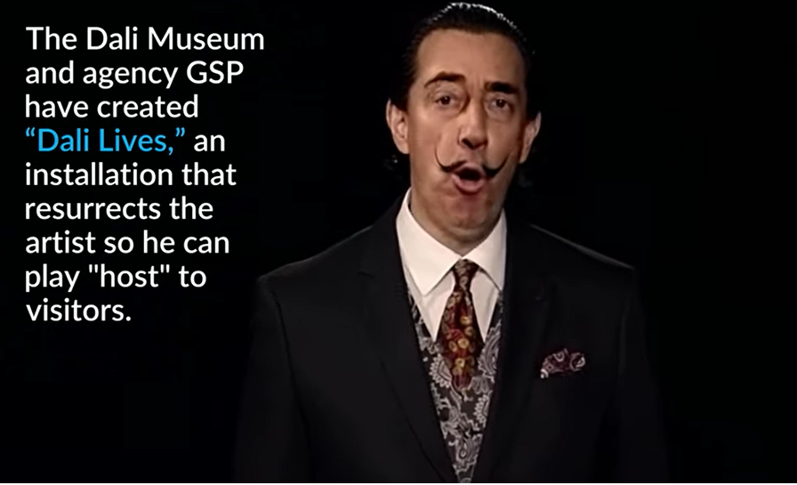
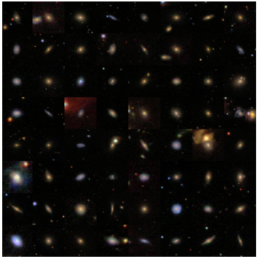
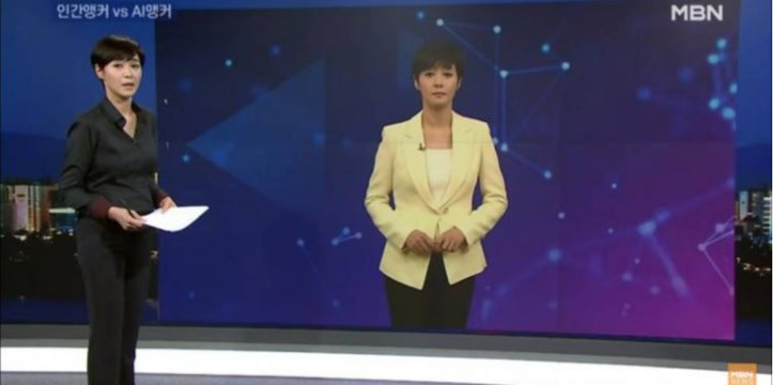
Related work
The late artist, Salvador Dali was faked to life in 2019 and made to welcome visitors to the museum.
A South Korean cable channel duplicated one of its anchors allowing continuous news transmission.
Source: Kidd & Rees, 2022; Gelgel, 2020; Coccomini et al., 2021.
Notes:
Most work on generative models has been done on natural media from everyday life settings. According to Kidd & Rees, 2022, in May 2019 the Dali Museum in Florida made an interactive deepfake creation of the late artist, Salvador Dali. Over 6,000 frames of videos from archival footage were used to bring Salvador to life and welcome visitors.
According to Gelgel, 2020, MBM Cable channel in South Korea duplicated one of its news anchors using GANs, allowing for continuous news transmission for 24 hours.
Coccomini & others, 2021 used 61,600 images from Galaxy Zoo dataset, trained for 3 days to generate synthetic images applying LightweightGAN. Their model was implemented with a batch size of 3, using Adam optimizer and a learning rate of 0.0002. Their experiment produced images hardly distinguishable from the original ones.
Like the work of Coccomini and others, our research trained 50,000 galaxy images from the Galaxy Zoo 2 dataset using Adam optimizer and a learning rate of 2e⁻⁴. However, we implemented our model using Deep Convolutional GAN and a batch size of 64, trained for 7 hours.

Slide 6
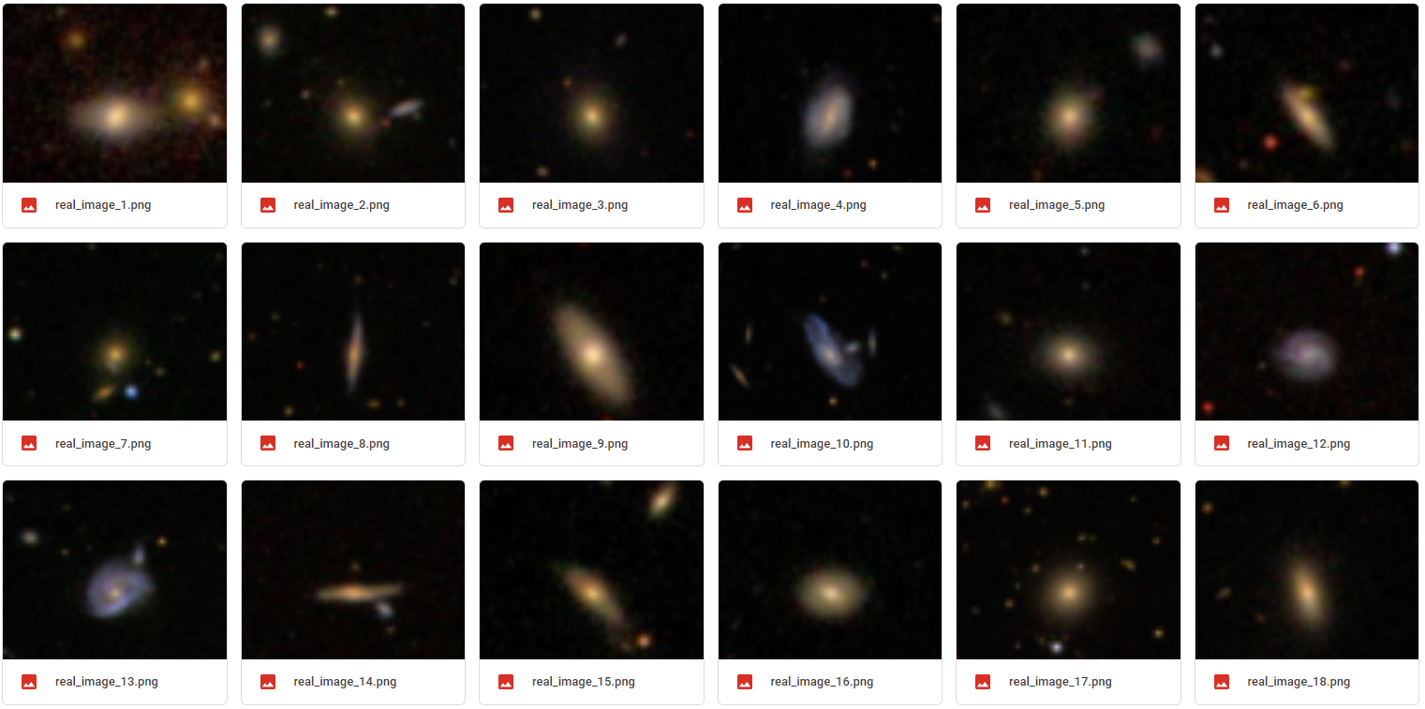
data
50,000 images of galaxies obtained from Galaxy Zoo 2 (Willett et al., 2013) were used for this research.
Notes:
The dataset for our research consists of 50,000 images of galaxies obtained from Galaxy Zoo 2, a large hub containing millions of galaxies drawn from astronomical surveys captured with telescopes.

Slide 7
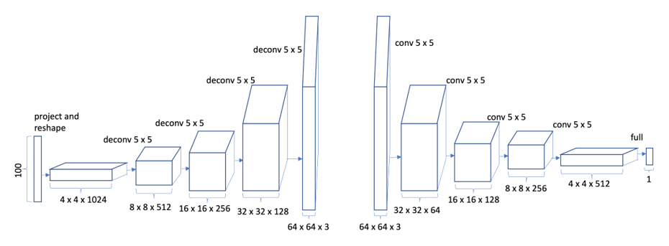
methodology
Deep Convolutional GAN (DCGAN) architecture.
For this research, we have chosen to use Deep Convolutional GAN, a variant of GAN excellent for unsupervised learning (Radford et al., 2015).
A latent tensor of shape (128 x 128 x 3) will be transformed into an image tensor of shape (64 x 64 x 3) by the generator.
Notes:
The idea behind GANs is simple, however, there are different variants of GANs used for specialized data synthesis tasks. For this research, we choose Deep convolutional GANs(DCGAN). Our preference for DCGAN was borne out of its architectural limitations which show that they are excellent candidates for unsupervised learning.
A vector of random values known as latent tensor is used as Generator’s input and serves as the image’s seed. A latent tensor of shape (128x128x3) will be transformed into an image tensor of shape (64x64x3) by the generator using the Convolutional Transpose2d layer.

Slide 8
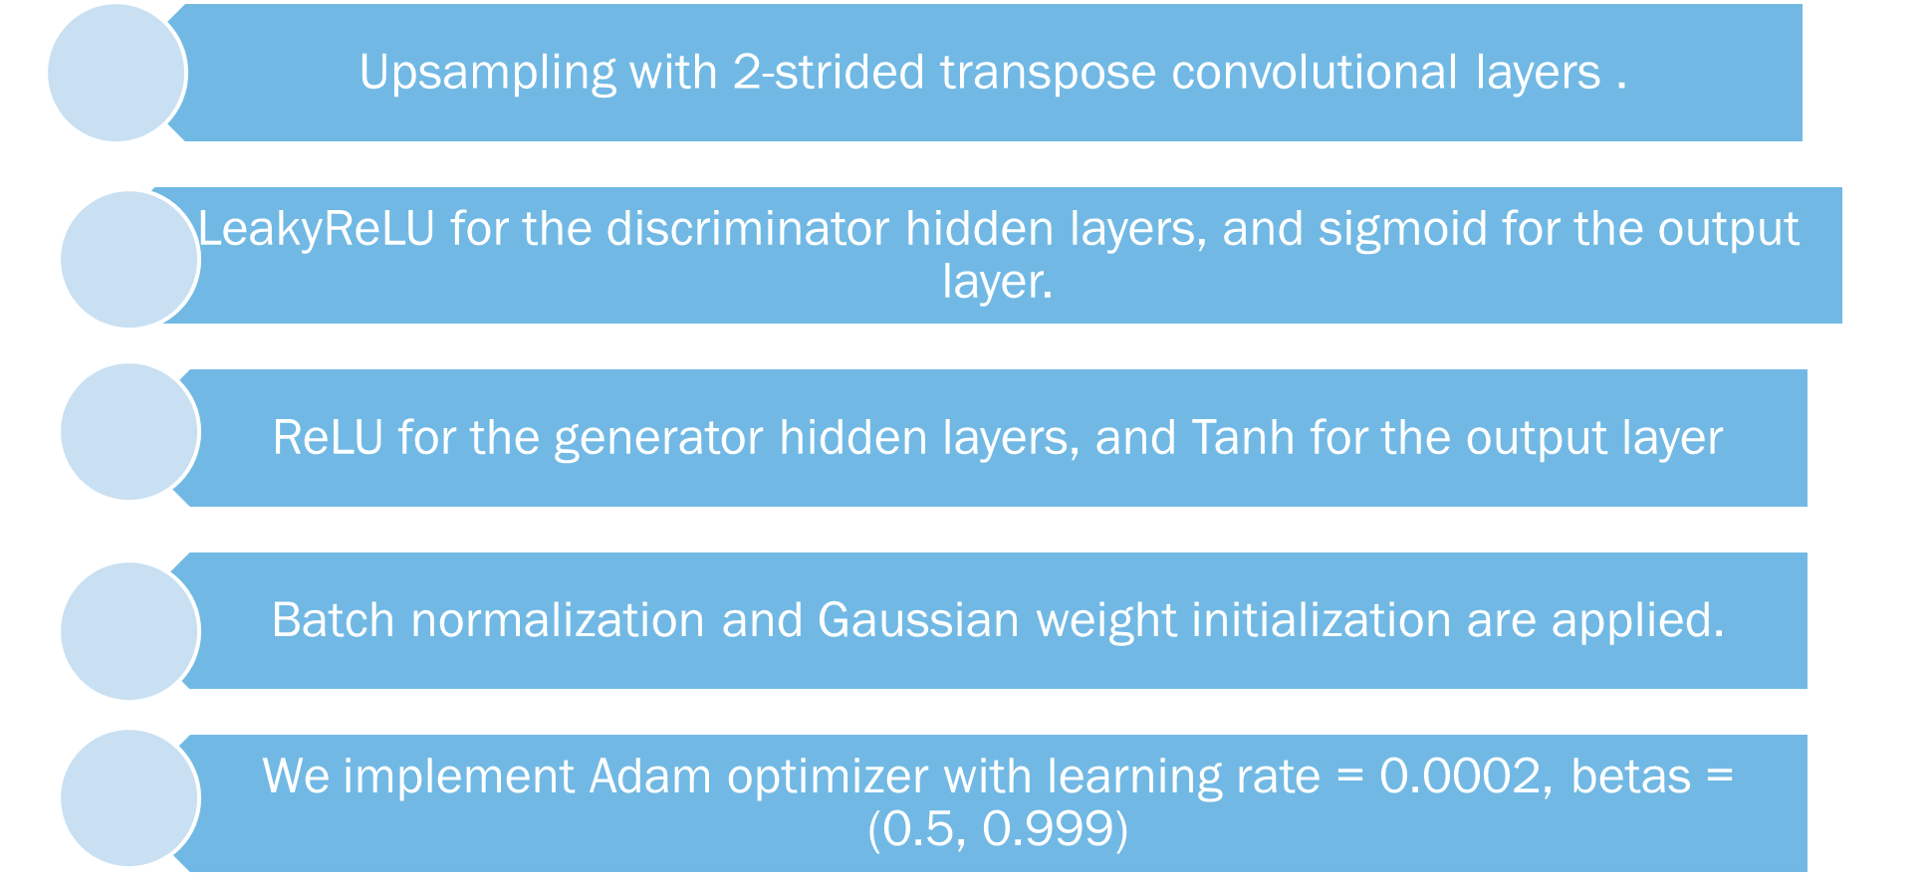
Deep convolutional gan (dcgan)
Notes:
As suggested by Radford and others (2015), the DCGAN was implemented using the following architecture:
¬ An up-sampling with 2-strided transpose convolutional layers was used instead of pooling layers.
¬ For the discriminator, LeakyReLU was used for the hidden layers and sigmoid for the output layer since the discriminator’s task is a binary classification.
¬ For the generator, we used ReLU for the hidden layers and Tanh for the output layer to keep the output image scale between -1 and 1.
¬ Batch normalisation and Gaussian weight initialization were applied to achieve a mean of zero and a standard deviation of 0.02.
¬ We implemented Adam optimizer with a learning rate = 0.0002. and betas(0.5, 0.999).

Slide 9
Dcgan training
Load data and divide into batches to feed model.
Initialize GAN network based on DCGAN method.
Execute training loop for 150 epochs
Generate some random noise
Remove some images from our dataset
Use Generator to create a vector, X
Create another vector, Y that corresponds to X
Tag generated images =0, real_images=0.9
Update the discriminator.
Notes:
We load the data and divide it into many batches to feed into our model.
We Initialised our GAN network based on the DCGAN methods.
We executed the training loop for 150 epochs.
We generated some random noise and removed some images from the dataset -> This ensured that created images from the same class do not all look the same.
The generator was then used to produce a vector, X that contains both fake and real; And another vector, Y that contains the correct responses.
Finally, we updated the discriminator.
** GAN training is alternate such that the generator is trained while holding the discriminator constant and vice versa. This is to ensure that both networks are of similar skills level.

Slide 10
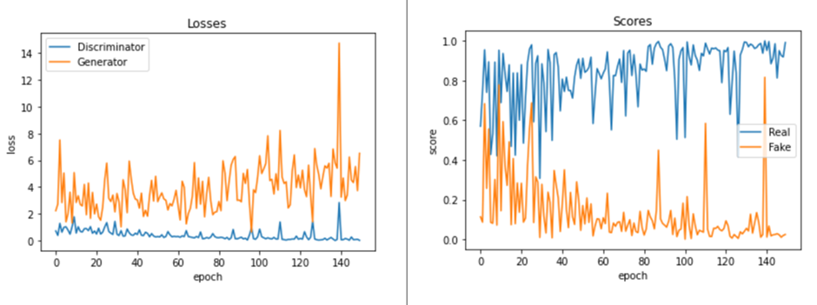
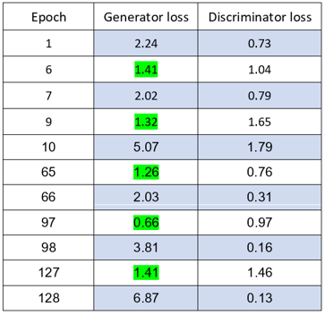
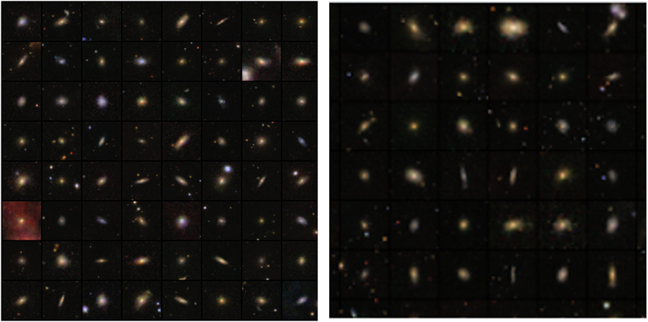
Results
The generator loss began at 2.24 while the discriminator loss started very low, at 0.73.
The minimax game continues until the discriminator fails to distinguish between real and fake images.
Notes:
Artificial images of galaxies were created using DCGAN. Here we show samples of generated images, the loss function graph, and a table describing how the minimax game of the Generator and the Discriminator losses played out on selected epochs.
The generator loss started at 2.24 while the Discriminator loss began lower at 0.73. This is not surprising as the generator would initially fail at fooling the discriminator before it learns to produce plausible galaxy images.
On epoch 9 for example, the generator successfully fooled the discriminator. Epoch 10 shows that the discriminator has quickly learnt from its error in the previous epoch and did better at classifying the images correctly. The same minimax game and improvement can be seen in epochs 97 & 98, 127 &128 until the discriminator fails to distinguish between real and fake images.
In a variety of problem domains, GANs have shown to be remarkably adept at producing high-quality synthetic images. Instead of being trained directly, the generator models are trained by a second model – the discriminator. As a result, the generator model lacks any objective function or objective measure. This makes it challenging to compare the effectiveness of various models. To measure the quality of data generated by our GAN model, we got a professional expert to judge whether the galaxies in the sample of two batches were real or fake.
Batch 1 = 52/64 ; Batch 2 = 61/64

Slide 11
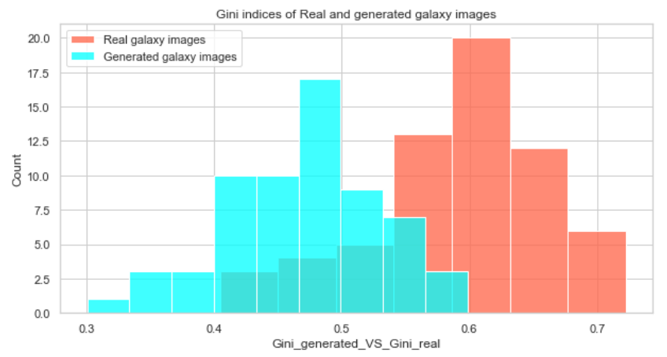

EVALUATION OF RESULTS - gini index
The Gini index (GI) is a measure of the probability that a given variable will be incorrectly classified when it is randomly selected (Gini, 1936).
GI is calculated as:
Pi = likelihood of an image being mapped to a class.
Gini index
Notes:
For this research, The Gini Index and Smoothness were used as quantitative evaluation metrics.
The Gini index is a widely used economic metric that measures how equally distributed the wealth of a country/region is. For our research, the Gini Index calculates at pixel level the likelihood that a given variable will be incorrectly classified when it is randomly selected.
The Gini index ranges from 0 to 1.
Where 0 indicates that all elements belong to a single class,
and 1 indicates that the elements are spread randomly across the classes.
The basis for our use of Gini stems from its capacity to gauge the homogeneity of the pixels within a space to assess the quality of created galaxy images.
The Gini Index for each real and artificial galaxy image in the sample batch of 64 was evaluated and represented in the histogram.
The GI of real galaxy images was distributed between 0.4 and 0.72
The GI of artificial galaxy images was distributed btw 0.3 and 0.6
We, therefore, performed a hypothesis test on the significant difference btw the GI of the real and artificial galaxies.

Slide 12
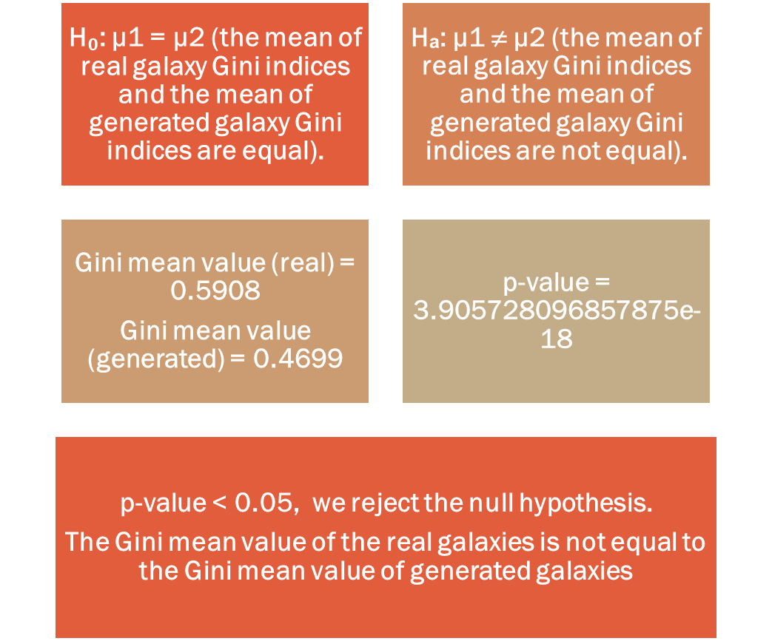
Hypothesis test (Gini index)
Notes:
From the Gini mean value of real and artificial galaxies, we got a p-value of 3.905e⁻18. As this is < 0.05, we reject the null hypothesis.
We have sufficient evidence to conclude that the Gini mean value of real galaxies is not equal to that of artificial galaxies.
Since we rejected the null hypothesis, it means that we have not quite faked the images that the computer will be able to recognize the fake images.

Slide 13
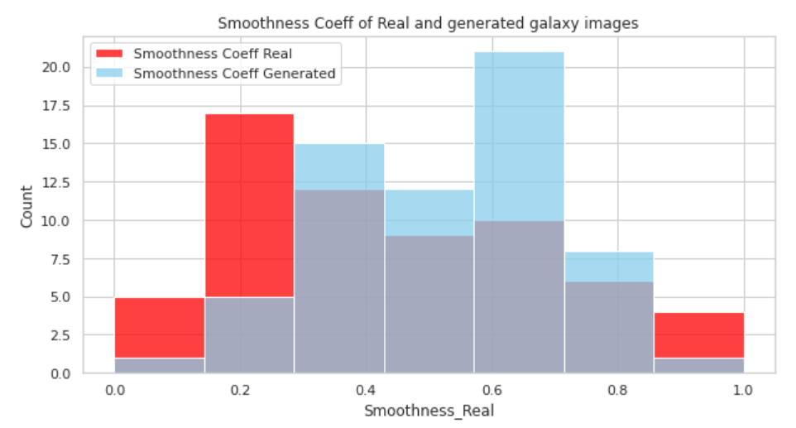
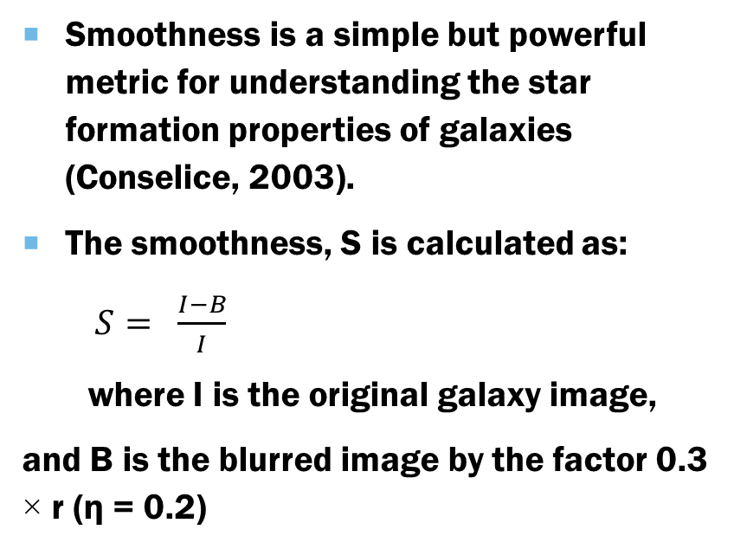
EVALUATION OF RESULTS - smoothness
Smoothness is a simple but powerful metric for understanding the star formation properties of galaxies (Conselice, 2003).
The smoothness, S is calculated as:
$S= \frac{I−B}{I}$
where I is the original galaxy image,
and B is the blurred image by the factor 0.3 × r (η = 0.2)
Notes:
The smoothness or clumpiness is the ratio of the amount of light contained in high-frequency structures to the total amount of light in the galaxy.
The Smoothness of each real and artificial galaxy image in the sample batch of 64 was evaluated and represented in the histogram.
The smoothness of real and artificial galaxies was in the same distribution from 0 to 1 as revealed in the Histogram. We, therefore, perform a hypothesis test to compare their smoothness.

Slide 14
HyPOTHESIS TEST - smoothness
H₀: µ1 = µ2 (the mean of real galaxy Smoothness = the mean of generated smoothness).
Hₐ: µ1 ≠ µ2 (the mean of real galaxy smoothness ≠ the mean of generated galaxy smoothness).
p-value = 0.06380153230215922
Since the p-value > 0.05, we accept the null hypothesis.
Smoothness real
mean value= 0.4466
Smoothness generated
mean value=0.5180
Notes:
From the smoothness mean value of real and artificial galaxies, we got a p-value of 0.0638, which is > 0.05, therefore we accept the null hypothesis.
This means that the artificial galaxy images have the same smoothness as the real images.

Slide 15
BEnCHMARK
During a visual evaluation of sample batches by an expert, 88.3% of the generated images were classified as real.
This is considered successful and some step ahead of previous works.
FUTURE WORK
Free AdverSarial Training (FASTGAN) for better image generation in less time.
.
Implement research with fit format – lossless images.
.
Galaxy2Galaxy – aimed at producing generative models for astronomical images.
Notes:
The work of Coccomini & others produced galaxy images hardly distinguishable from real galaxies, their result was however not quantified. The result of our qualitative evaluation yielded 88.3% success in terms of real images therefore there is no parallel measure to compare our work with the past work done. Also, their work trained the network for 3 days while we trained for 7 hours. We also used GINI and Smoothness as quantitative metrics. These have not been used in previous works; hence our work has taken steps ahead at quantifying results. Given more time, we would like to improve the quality and speed of our GAN model using Free AdverSarial Training, FastGAN, an efficient algorithm capable of achieving better image generation quality in less training time. In the future, we would implement this research with galaxy images in their original fit format – because unlike jpeg/png, fits images are lossless. Also, Galaxy2Galaxy, a library of datasets, utilities, and models would be used to produce generative models for astronomical images. (Lanusse et al., 2021).

Slide 16
conclusion
The expert rated 113 generated galaxy images out of 128 as real, representing 88.3% success.
The smoothness mean values for real and generated images were 0.4466 and 0.5180 respectively, estimated as the same based on hypothesis test.
The Gini mean values for real and generated galaxies were evaluated as 0.5908 and 0.4699 respectively.
After 150 epochs of training, about 80% of real scores achieved were above 0.9 while close to 80% of fake scores were below 0.2.
Notes:
The expert judged 113 out of 128 artificial galaxy images as real, representing 88.3% success.
Evaluation with Gini Index revealed via hypothesis test that the Gini mean value of real images was not the same as the Gini mean value of artificial galaxies.
Evaluation with smoothness showed via hypothesis test that the smoothness mean values of real and artificial galaxies were the same.
After 150 epochs, close to 80% of real scores achieved were above 0.9, while about 80% of fake scores were below 0.2.
In conclusion, I created a GAN to fake galaxy images and fooled the expert.

Slide 17
references
Coccomini, D., Messina, N., Gennaro, C., & Falchi, F. (2021). Generative Adversarial Networks for Astronomical Images Generation. arXiv preprint arXiv:2111.11578.
Conselice, C. J. (2003). The relationship between stellar light distributions of galaxies and their formation histories. The Astrophysical Journal Supplement Series, 147(1), 1.
Gelgel, N. M. R. A. (2020). Will technology take over journalism?. power, 153, 164.
Gini, C. (1936). On the measure of concentration with special reference to income and statistics. Colorado College Publication, General Series, 208(1), 73-79.
Goodfellow, I., Pouget-Abadie, J., Mirza, M., Xu, B., Warde-Farley, D., Ozair, S., ... & Bengio, Y. (2014). Generative adversarial nets. Advances in neural information processing systems, 27.
Kidd, J., & Rees, A. J. (2022). A MUSEUM OF DEEPFAKES?. Emerging Technologies and Museums: Mediating Difficult Heritage, 218.
Radford, A., Metz, L., & Chintala, S. (2015). Unsupervised representation learning with deep convolutional generative adversarial networks. arXiv preprint arXiv:1511.06434.
Vint, D., Anderson, M., Yang, Y., Ilioudis, C., Di Caterina, G., & Clemente, C. (2021). Automatic Target Recognition for Low-Resolution Foliage Penetrating SAR Images Using CNNs and GANs. Remote Sensing, 13(4), 596.
Willett, K. W., Lintott, C. J., Bamford, S. P., Masters, K. L., Simmons, B. D., Casteels, K. R., ... & Thomas, D. (2013). Galaxy Zoo 2: detailed morphological classifications for 304 122 galaxies from the Sloan Digital Sky Survey. Monthly Notices of the Royal Astronomical Society, 435(4), 2835-2860

Slide 18
